Slide 1
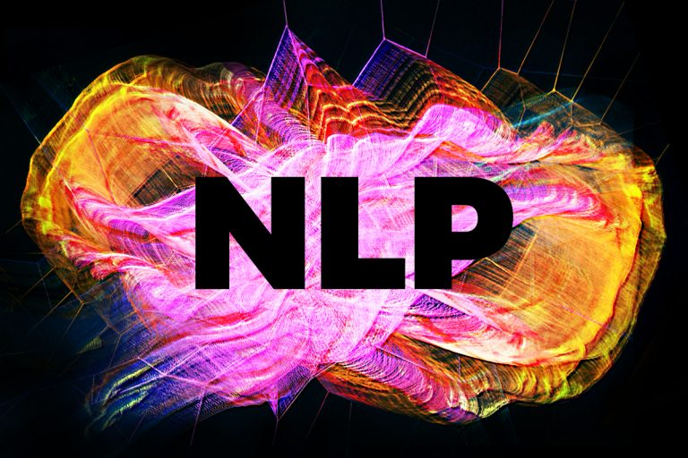
Natural Language Processing

Slide 2
Overview
About Me
What is NLP
Applications of NLP
Common Types of Datasets for NLP
Python Tools for NLP
Datasets for Today’ session
Series of Practical Sessions

Slide 3

About Me
Davis David
Data Scientist @dLab 👉 Software Developer & Technical Writer
Email: me@davisdavid.com or davisdavid179@gmail.com
Profile: davisdavid.com
Twitter: @Davis_McDavid

Slide 4
What is NLP
NLP stands for Natural Language Processing. It is a field of AI and computational linguistics that focuses on the interaction between computers and human language.
NLP aims to enable computers to understand, interpret, and generate natural language text or speech.
NLP combines computational linguistics, rule-based modeling of human language with statistical, machine learning, and deep learning models. Together, these technologies enable computers to process human language in the form of text or voice data.

Slide 5
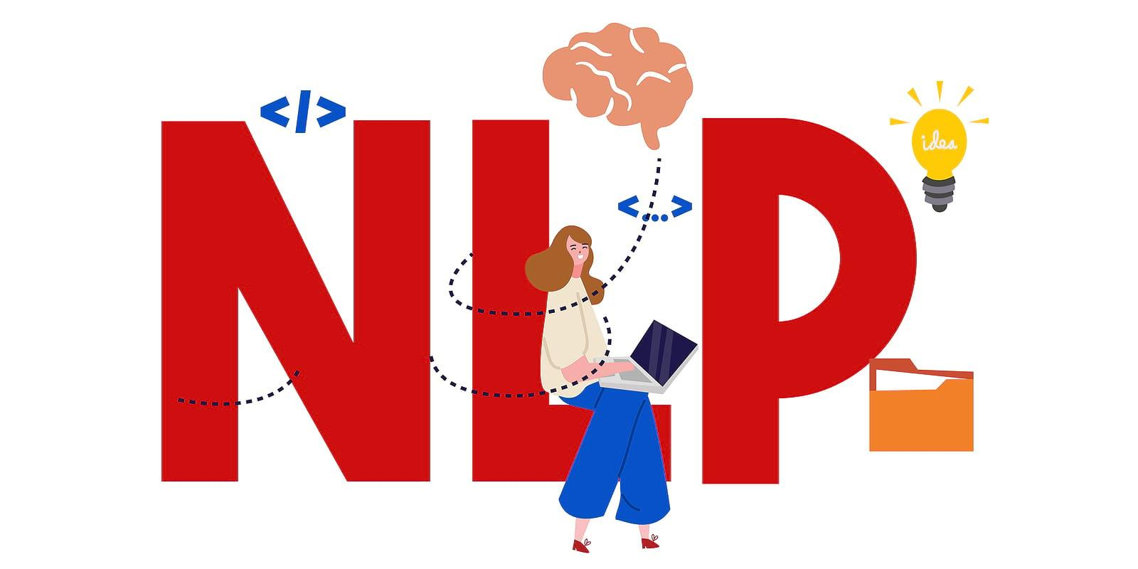
Applications of NLP

Slide 6
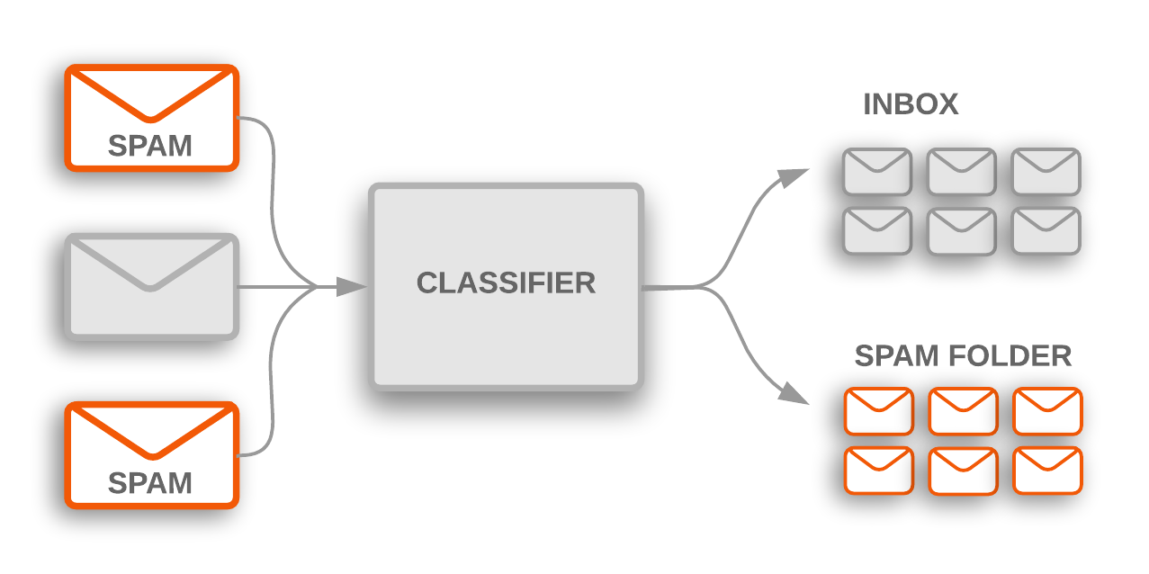
1.Text Classification
Text Classification: Categorizing text into predefined categories or classes based on its content.
This is useful for:
Document classification
Spam filtering
News categorization
Content recommendation.

Slide 7

2.Sentiment Analysis
Sentiment Analysis: Analyzing text to determine the sentiment expressed, such as positive, negative, or neutral.
It is used in:
Social media monitoring
customer feedback analysis
Brand reputation management.

Slide 8
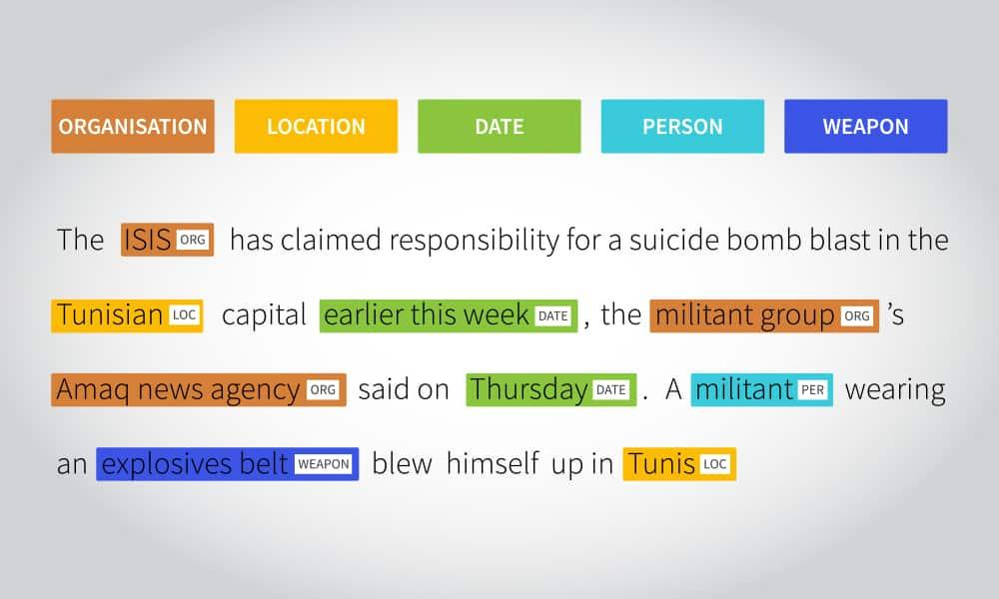
3. Named Entity Recognition
Named Entity Recognition (NER): Identifying and extracting named entities such as person names, locations, organizations, dates, and more from text.
It is used in:
Information extraction
Knowledge graph construction
Data mining.

Slide 9
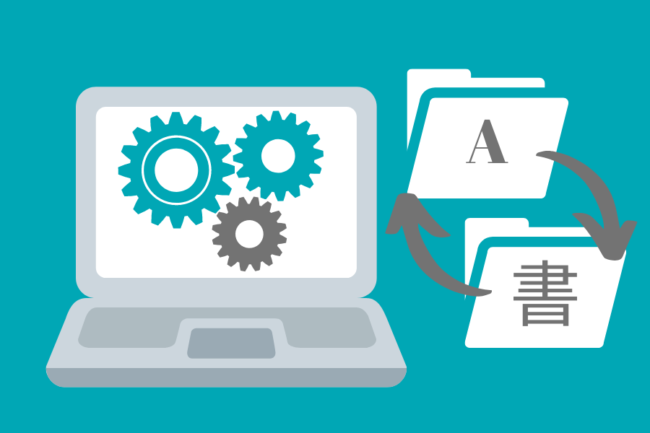
4.Machine Translation
Machine Translation is the process of using AI to automatically translate text or speech from one language to another. Example from Swahili to English.
Machine translation systems like Google Translate utilize NLP techniques to automatically translate text.

Slide 10
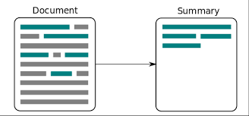
5.Text Summarization
Generating concise summaries of longer texts, such as news articles, research papers, or legal documents.
Text summarization helps in information retrieval and efficient content consumption.
Example: Hackernoon.com (TLDR)

Slide 11
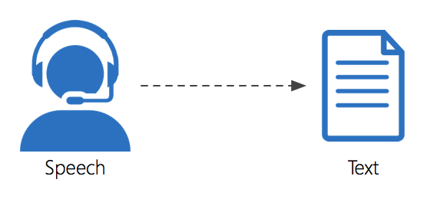
6.Speech Recognition
Speech Recognition: Converting spoken language into written text.
NLP techniques are employed in speech recognition systems used for:
Transcription
Voice assistants
Voice-controlled devices.
Examples: Siri and Google Assistant

Slide 12

7.Conversational AI
Chatbots and Virtual Assistants: Creating conversational agents that can understand and respond to natural language queries or commands.
NLP is used to process user input, generate appropriate responses, and handle dialogues.
Virtual Assistants: Alexa, Cortana, Google Assistant and Siri
ChatGPT from OpenAI
Bard from Google

Slide 13

8.Autocomplete
Autocomplete, or sentence completion, combines NLP with certain machine learning algorithms in order to predict the likelihood of a following word or sentence to complete the meaning. Example: Google Search and Gmail.

Slide 14
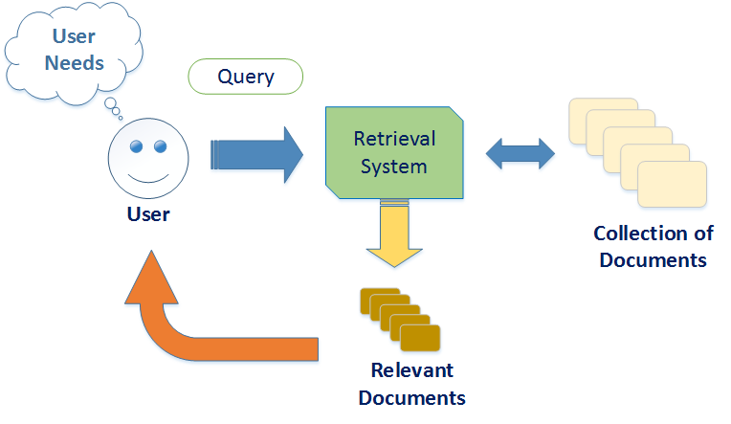
9.Information Retrieval
Information Retrieval: Retrieving relevant documents or information from a large corpus based on user queries. Search engines use NLP techniques to understand user queries and match them with relevant documents. Example: Google search engine and Bing search engine

Slide 15
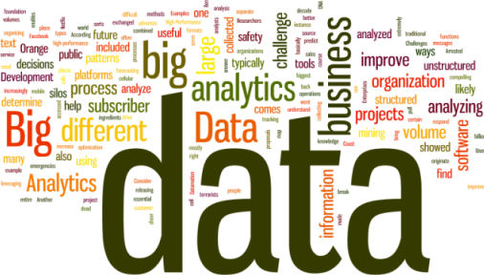
Types of Datasets Used in NLP

Slide 16
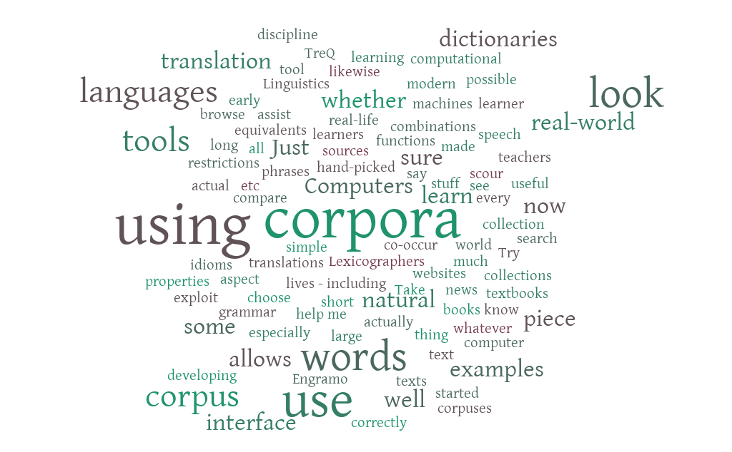
1. Text Corpora
Text Corpora are large collections of text documents that serve as the foundation for training various NLP models.
Text Corpora can include sources such as books, articles, web pages, social media posts, chat logs, and more.

Slide 17
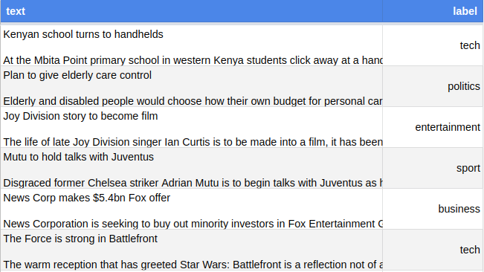
2. Labeled Datasets
Labeled Datasets: These datasets have text documents or sentences that are manually annotated with labels or tags.
For example, sentiment analysis datasets have text samples labeled as positive, negative, or neutral.
Named entity recognition datasets have text annotated with named entities such as person names, locations, organizations, etc.

Slide 18
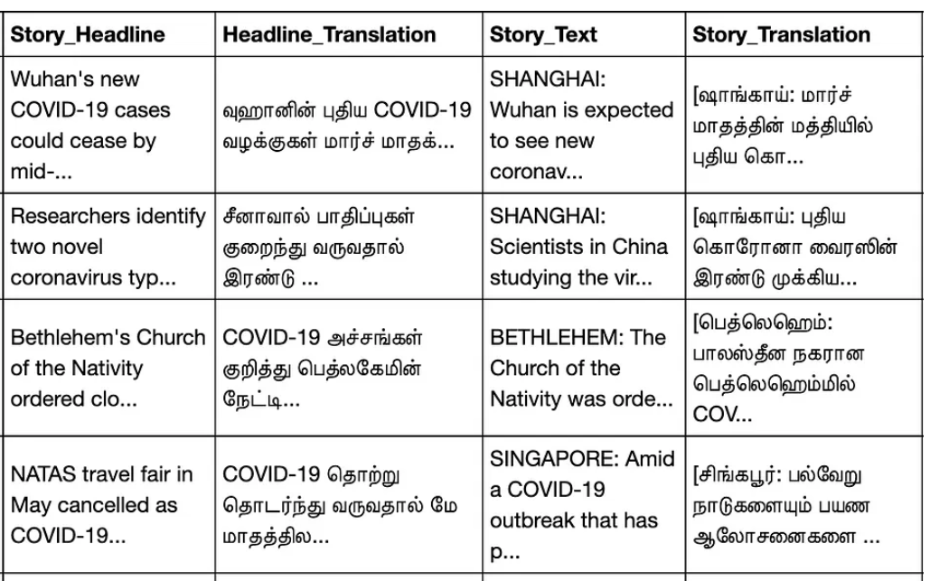
3. Machine Translation Datasets
Machine Translation Datasets: These datasets consist of parallel text in multiple languages.
Each sentence or phrase in one language is paired with its corresponding translation in another language.
These datasets are used to train machine translation models.

Slide 19
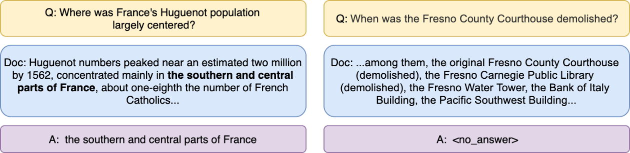
4. Question-Answering Datasets
Question-Answering Datasets: These datasets include questions and their corresponding answers.They are used to train question-answering models to understand and respond to user queries.

Slide 20
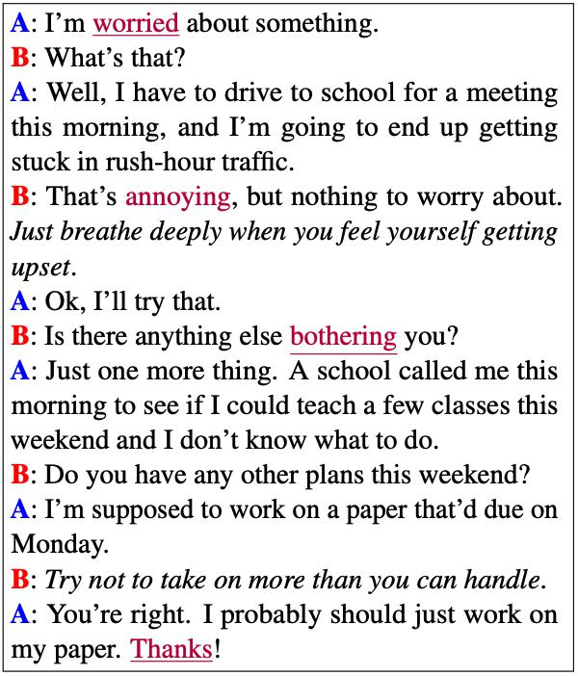
5. Dialogue Datasets
Dialogue Datasets: These datasets capture conversational interactions between users and systems. They are used to train chatbots, virtual assistants, and dialogue systems.

Slide 21
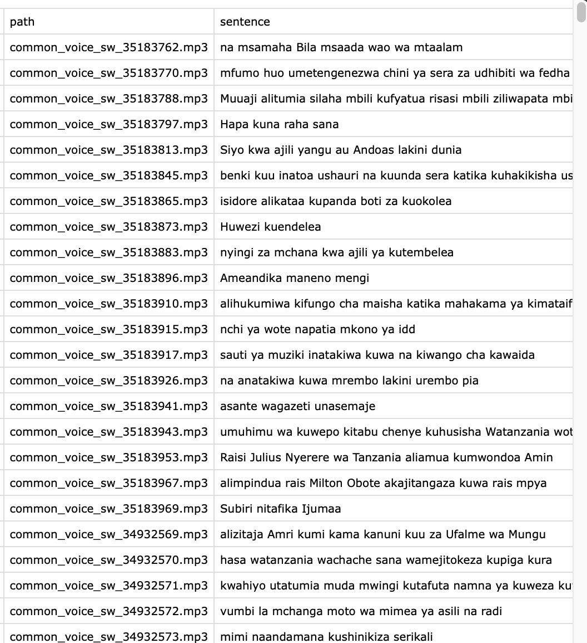
6. Speech Datasets
Speech Datasets: These datasets consist of audio recordings paired with transcriptions or text labels. They are used for training speech recognition and speech-to-text models.

Slide 22
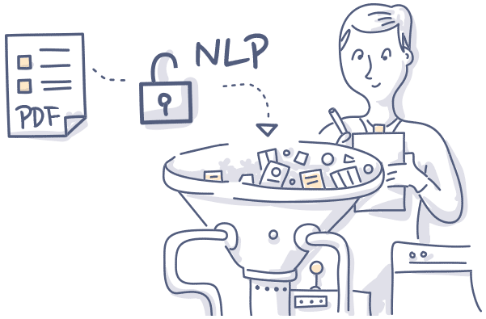
7. Domain-Specific Datasets
Domain-Specific Datasets: Some NLP applications require specialized datasets tailored to specific domains.
For example, in medical NLP, datasets may include clinical notes, electronic health records, or biomedical literature.

Slide 23
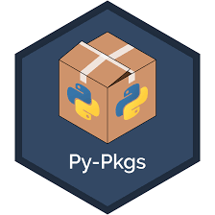
Python Tools for NLP

Slide 24
Python Tools for NLP
1. NLTK (Natural Language Toolkit): A comprehensive library for NLP tasks like tokenization, POS tagging, parsing, and more.
2. spaCy: A fast and efficient NLP library for various NLP tasks, including tokenization, named entity recognition and word vectors.
3. Gensim: A library for topic modeling and document similarity using techniques like LDA (Latent Dirichlet Allocation) and Word2Vec.
4. TextBlob: A simple NLP library built on top of NLTK and Pattern for tasks like sentiment analysis, part-of-speech tagging, noun phrase extraction, and more.
5. Scikit-learn: A popular machine learning library with NLP capabilities, including text classification, clustering, and feature extraction.

Slide 25
Python Tools for NLP
6. Transformers (formerly Hugging Face Transformers): A library that provides access to a vast collection of pre-trained transformer-based language models, making it easy to use advanced NLP models like BERT, GPT, and more.
7. AllenNLP: A research-oriented NLP library that simplifies the implementation of state-of-the-art models for tasks like text classification, reading comprehension, and more.
8. Flair: A framework for state-of-the-art NLP that provides embeddings, contextualized word representations, and allows you to build custom NLP models.
9. Pattern: A web mining and natural language processing library that includes modules for sentiment analysis, part-of-speech tagging, and more.
10. StanfordNLP: A Python wrapper for the Stanford CoreNLP library, providing a range of NLP capabilities such as tokenization, POS tagging, and dependency parsing.

Slide 26
Python Tools for NLP
11.Tensorflow:
TensorFlow is an open-source deep learning framework developed by Google. For NLP, TensorFlow can be used for tasks such as text classification, sequence-to-sequence models, language translation, sentiment analysis, and more.
12.Pytorch:
PyTorch is an open-source deep learning framework developed by Facebook's AI Research lab (FAIR). PyTorch can be effectively used for building NLP models, ranging from simple tasks like text classification to more complex tasks like sequence labeling and machine translation.
13.Nemo:
NVIDIA NeMo (Neural Modules) is an open-source Python framework developed by NVIDIA for building and training conversational AI models, including Natural Language Processing (NLP) models(STT,TTS), Text classification and other NLP tasks.

Slide 27
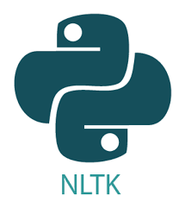
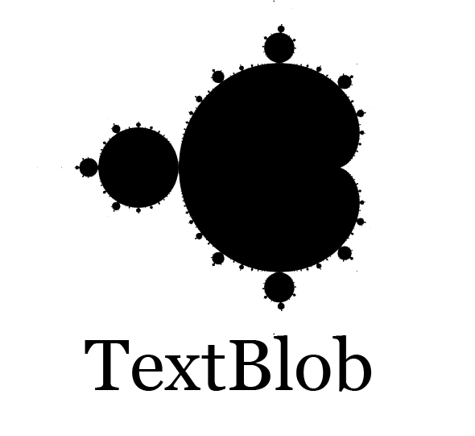
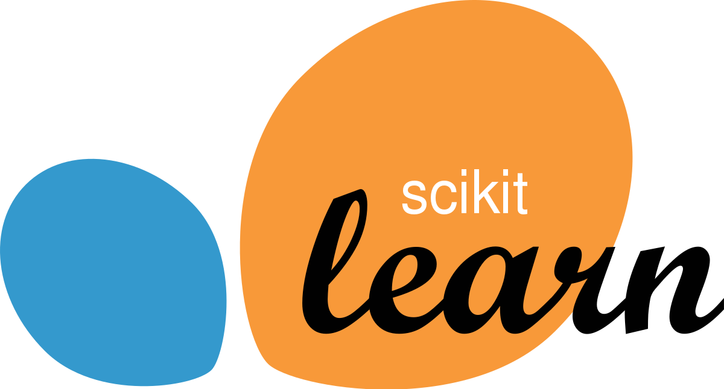

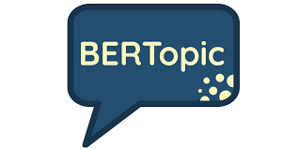

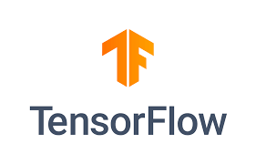



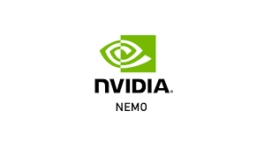

Python Tools for NLP

Slide 28
Datasets for Today’s Session
Swahili News Headlines: e.g Political,health,sports, economy,international
Swahili News Articles: e.g Political,health,sports, economy,international

Slide 29
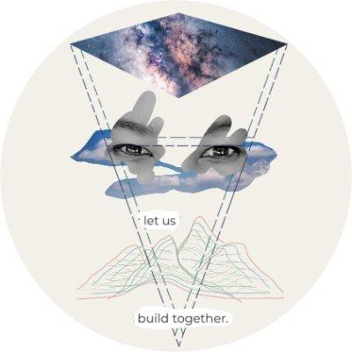
Masakhane Community
A grassroots NLP community for Africa, by Africans.
Website:https://www.masakhane.io/
Slack: https://masakhane-nlp.slack.com/

Slide 30
Questions & Answers

